Slide 1

Printing Non-uniformity of Various Commercial Presses
Visualization, Analysis, and Comparison of test data from Lithographic and Electrophotographic presses
by Saleh Abdel Motaal

Slide 2
Good Morning!
Graduate Research Symposium 2011
Around 65 Presentation
Around 20 Posters
Thank you to the Team members behind this huge & successful symposium.

Slide 3
Good Morning!
Myself:
B. Tech. in Graphic Communications Management Ryerson University, Toronto
2nd yr. M. Sc. in Print Media, Rochester Institute of Technology
Entrepreneurship, Software Engineering
Just starting my own venture, GRASSPE, focusing on Graphic Arts Software

Slide 4
Good Morning!
My Project:
Goal is to test for consistent of printing on in and across sheets
4 years, 3 separate studies, one conclusion!
Great advisors and colleagues

Slide 5
Introduction!
Density versus Colorimetry
Accuracy & Repeatability
Ink Film Thickness & Variability

Slide 6
Density versus Colorimetry (IFT)
Densitometry: complimentary filters for process colors
Measures absorption of chromatic colorants relative to white
Does not measure ink film thickness
Colorimetry: tristimulus integration that models human vision
Ties to the visual perception of resulting color, Does not directly tie to the absorption of process inks
Does not measure ink film thickness
Notes:
In other words, IFT is something we estimate under given circumstances and is validly comparable under similar circumstances
Colorimetry on the other hand is abridged measure of the end-result within the absolute boundaries of a mathematical model

Slide 7
CIE-LAB, ∆E How much can we tolerate!

Slide 8


Accuracy vs. Repeatability
(Wikipedia: Accuracy and precision)
Accuracy: center of the target (variation/aims)
Repeatability: closely spread (deviation/tolerances)
High accuracy and repeatability is desired!
This is the same as low deviation & low variation
Notes:
This is equivalent to low deviation and variation as worded by ISO

Slide 9
Ink Film Thickness (IFT)
Ink keys control ink flow for axial band coverage
(Kipphan, Springer: Handbook of Print Media – 2001)
Notes:
• In lithography, ink keys are used to control the volume of the ink flow for each axial band on the sheet, based on the image coverage demand of the given zones so that equal Ink Film Thickness across varied zones is achieved.
• In theory, equal ink film thickness produces steady color, other factors aside, like surface factors.
• IFT entails printing density, and thus color, evenness of IFT entails evenness of color

Slide 10
We are more concerned with Repeatability

Slide 11
Spatial Variability
Sigg (2007), “unevenness of inking around the cylinder [circumferentially] is around 0.08 density”
(Sigg, TAGA – 2007)

Slide 12
Ink Film Thickness (IFT)
There is no adjustment for circumferential ink film thickness
(Kipphan, Springer: Handbook of Print Media – 2001)
Notes:
Conventionally, we have control over the axial bands
But, what happens within the bands, circumferentially is often taken for granted,
This is mainly due to the limited control we have, aside from having a good press!

Slide 13
Spatial or Temporal?
For optimist:
What if temporal uniformity is high?
What if spatial uniformity is high?
Most people like the status quo… Can this be achieved!
For pragmatist:
What if temporal non-uniformity is a significant concern?
Fix press settings, inks, substrate, or, buy a more uniform press
What if spatial non-uniformity is a significant concern?
Multiple targets need to be used
Where to position targets and image elements will have an impact
Notes:
Today, process control is inherently a localized practice!
Our targets are stationary to one or two locations on the sheet

Slide 14
Prior Works

Slide 15
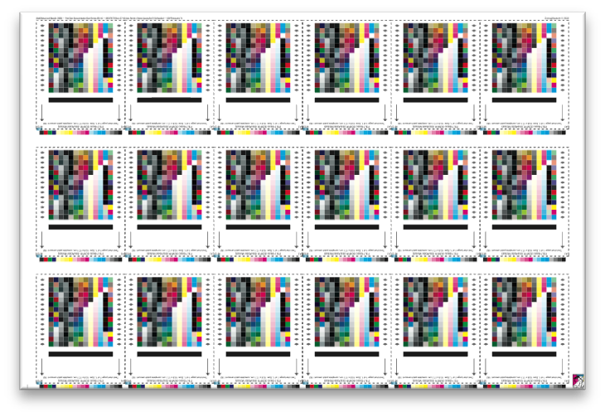
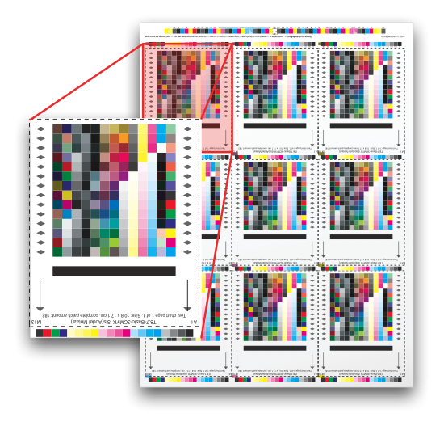
First Run w/ Density
9- and 18-up products for orientation
11 samples from 100 good sheets
iSis spectra to density and CIELAB
MatLab for number crunching
Notes:
The logic is to compare similar patches across the regions
Axial and circumferential central tendencies and dispersion are used for spatial comparisons for a number of sheets

Slide 16
First Run w/ Density
Can compare same patch:
Sheet-to-sheet (Temporal)
In-Sheet (Spatial)
Band-wise Axial or Circumferential
Zone-wise between two regions

Slide 17
Temporal Density Around
Notes:
The two presses are not tested for their merit as a product but only to the extent that they are significantly different designs as well as different inking models.
It is clear that temporal is significant, but it also seems that spatial is also significant… to be extact temporal accuracy and repeatability as a function of spatial position.
Notice, PM’s clear distinction from head to tail, we can see a pattern, but also keep in mind how circumferential bands can be erratic.

Slide 18
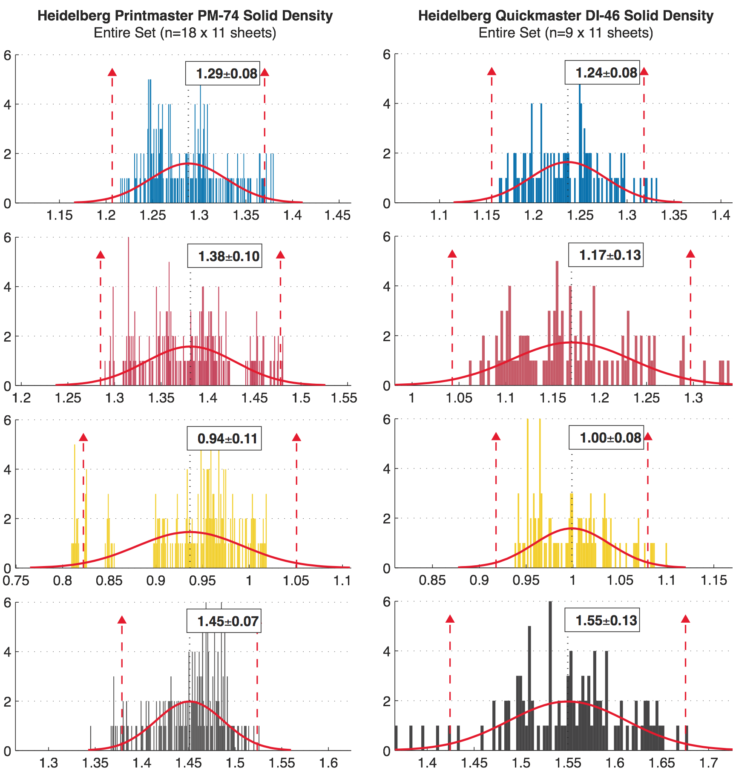
Density Across & In Sheets
Notes:
This is simply the value of each patch over the sampled sheets, so it’s 9- or 18- patches for each color for each sheet for 11 sheets
We cannot simply assume a normal distribution for both conditions

Slide 19
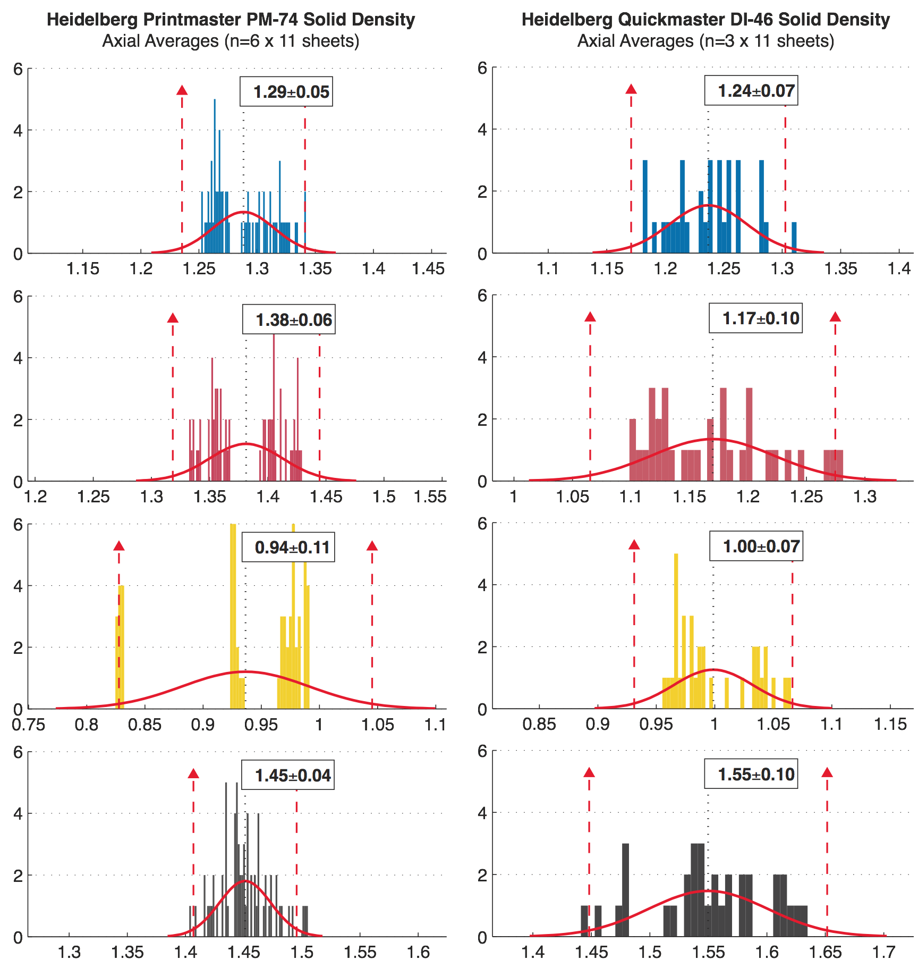
Density by Axial Bands Across Sheets
Notes:
Since we are not using density differences for each band, we should assume multinomial fitting based on the number of axial bands (3 for DI and 6 for PM)
The overlap and hard to see… but notice the yellow for the Print Master, obviously we miss adjusted the flow for one zone

Slide 20
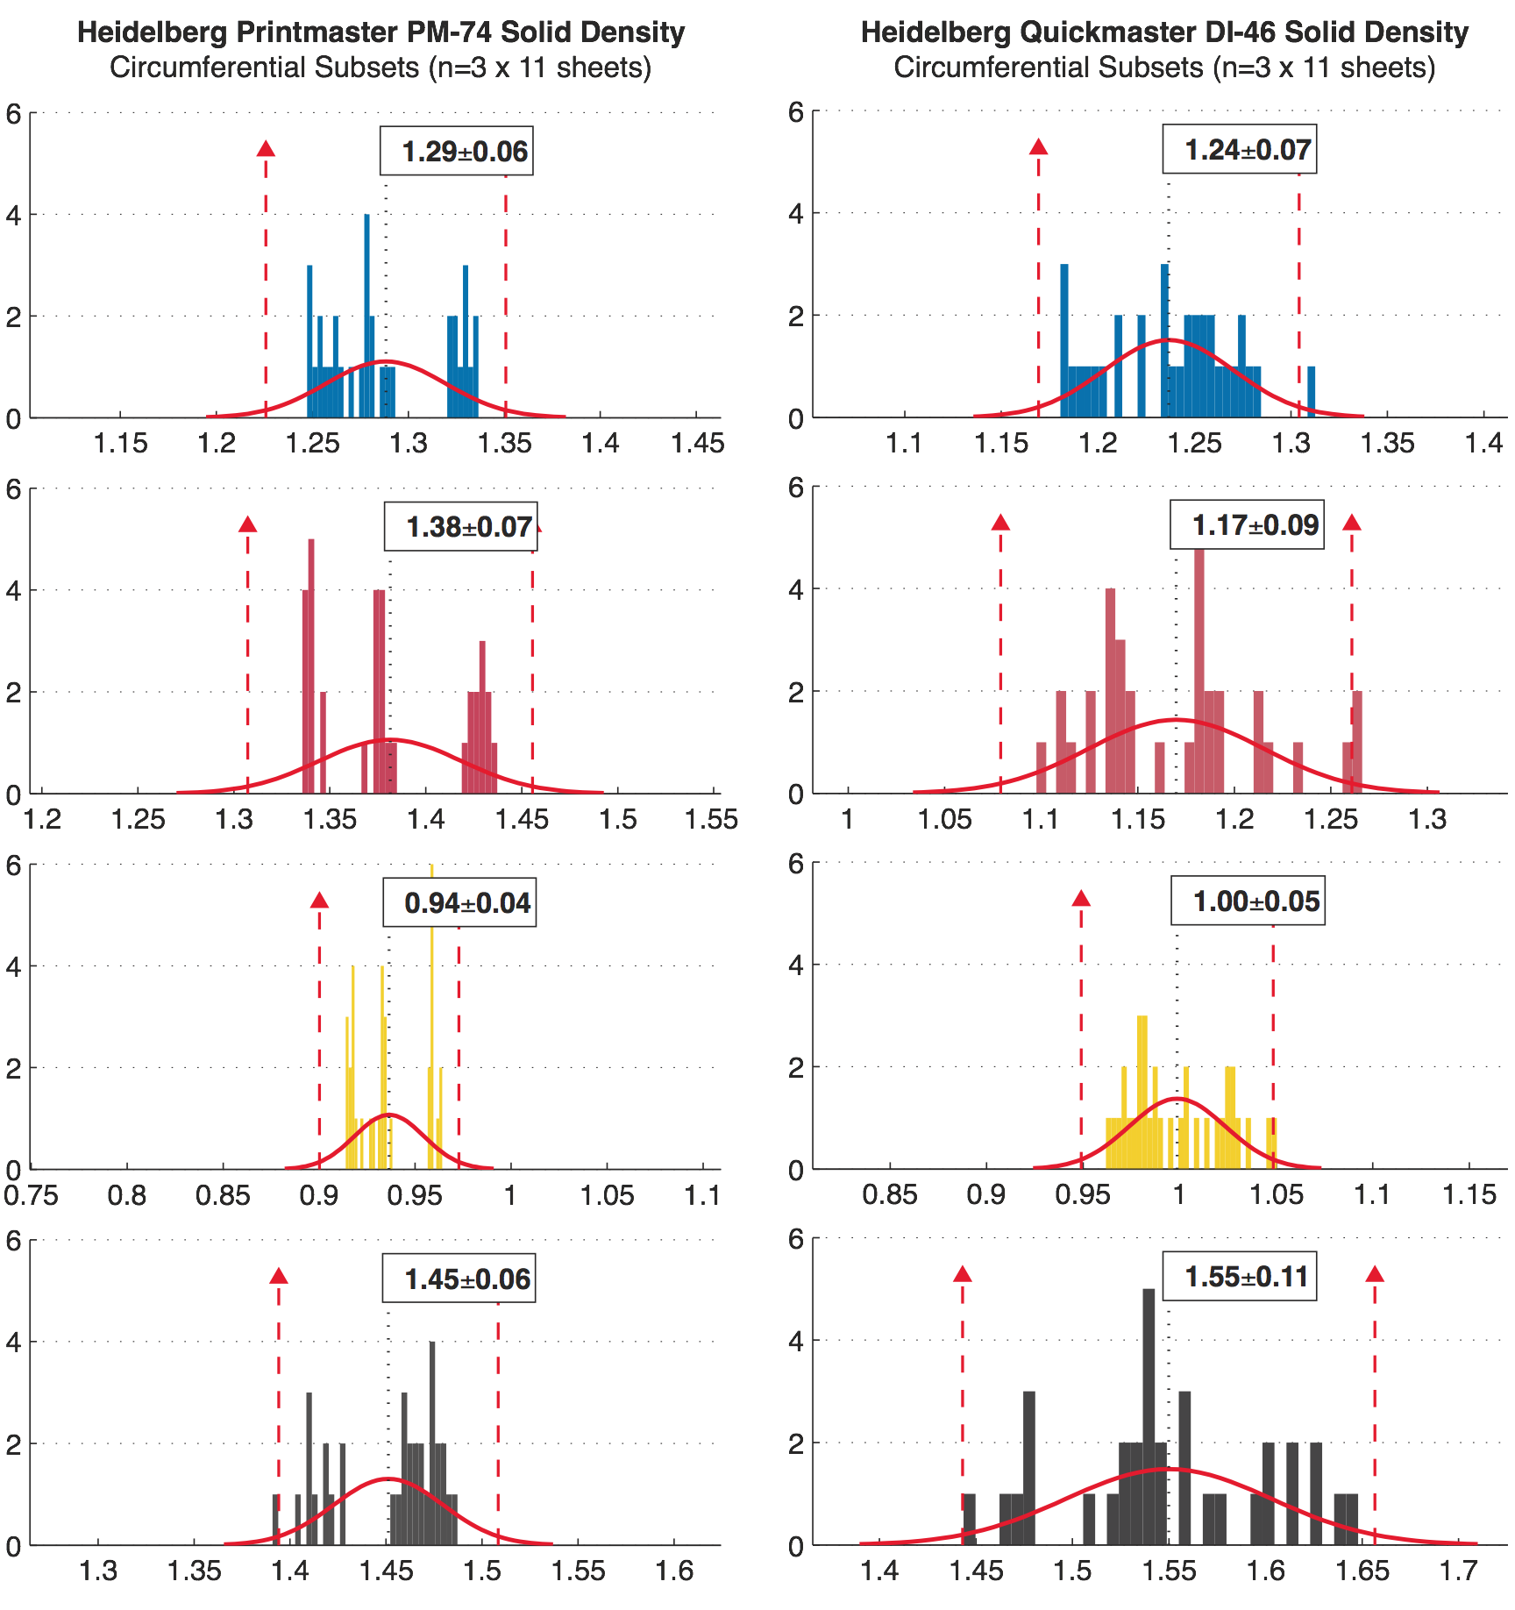
Density by Around Bands Across Sheets
Notes:
Since we are not using density differences for each band, we should assume multinomial fitting based on the number of axial bands (3 for DI and 6 for PM)
The overlap and hard to see… but notice the yellow for the Print Master, obviously we miss adjusted the flow for one zone

Slide 21
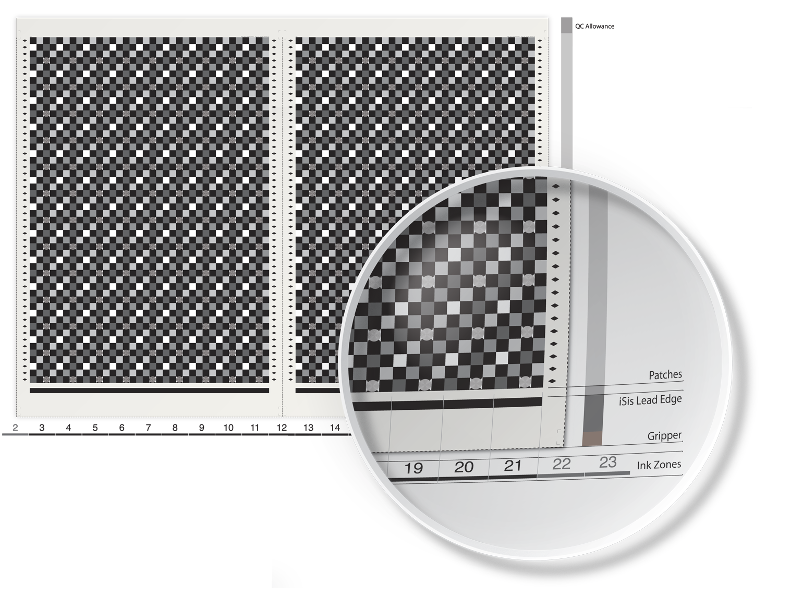
Current Work

Slide 22
New Approach
Print with one color / channel only
Less variables to worry about
Better control in pressroom
Less interference & noise
Higher sampling resolution
Print to compare
Print on the same unit twice
Print on two different units (with first as the control)
Print on two different devices
Print using two processes (lithography and electrophotography)

Slide 23
Looking at the data

Slide 24
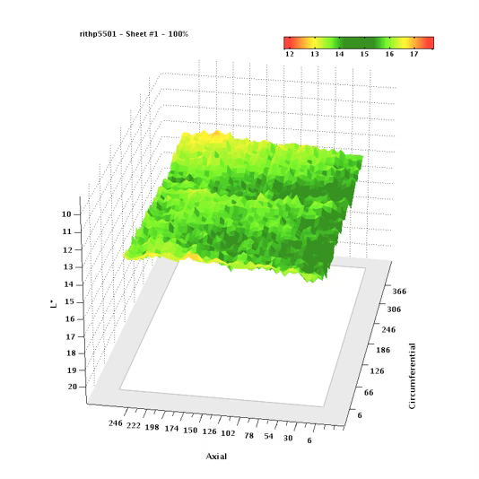
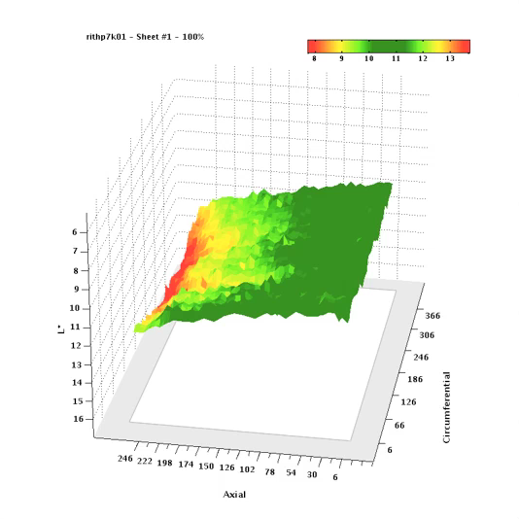
Two digital presses!
Solids

Slide 25
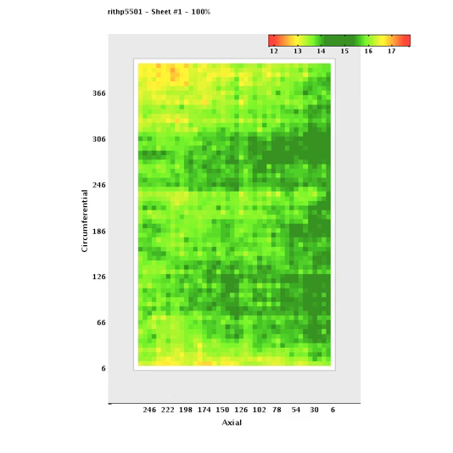
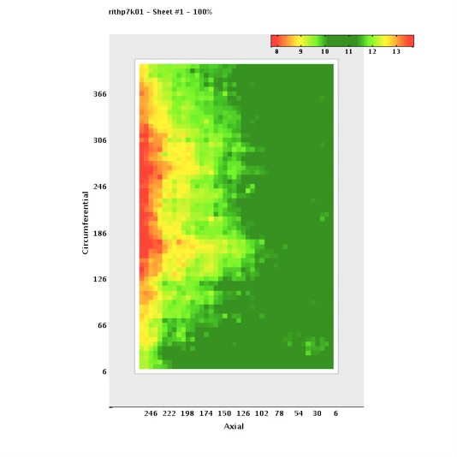
Two digital presses!
Solids

Slide 26
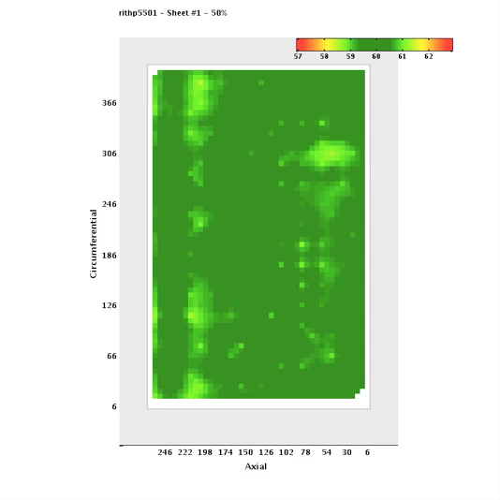
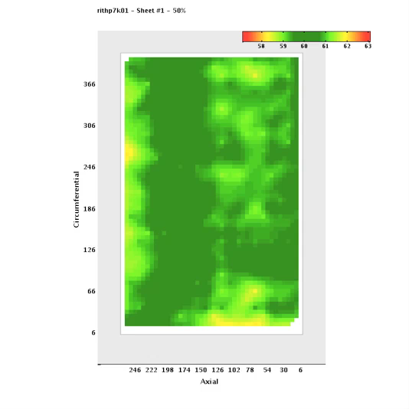
Two digital presses!
Midtones

Slide 27
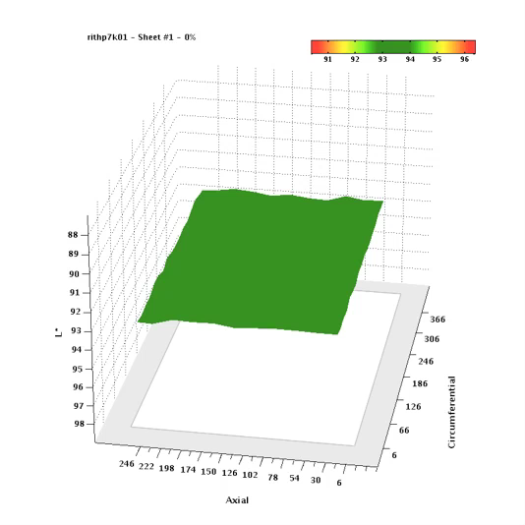
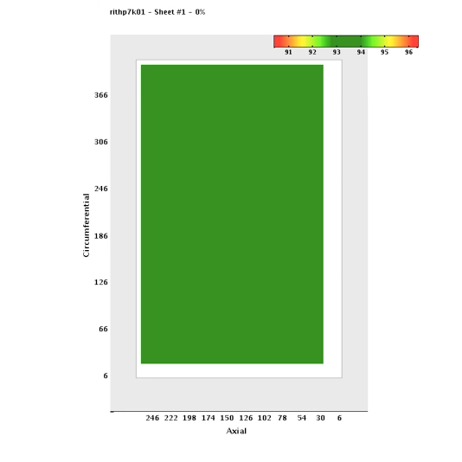
It’s not the paper!
Paper for one press

Slide 28
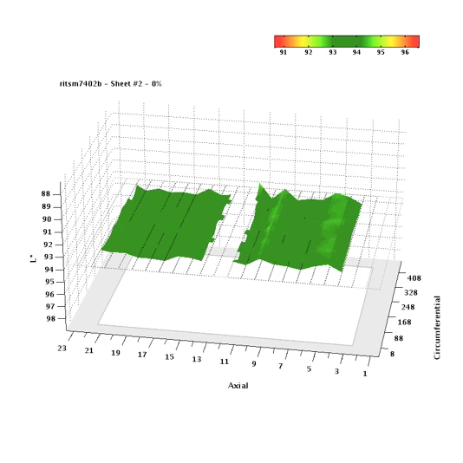
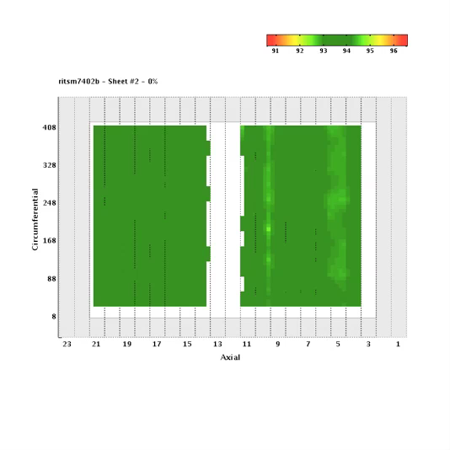
It’s not the paper!
Paper for another press

Slide 29
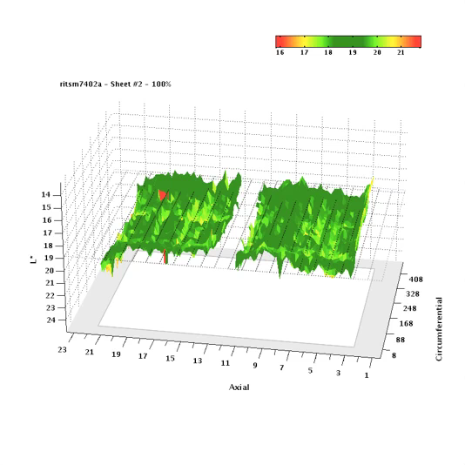
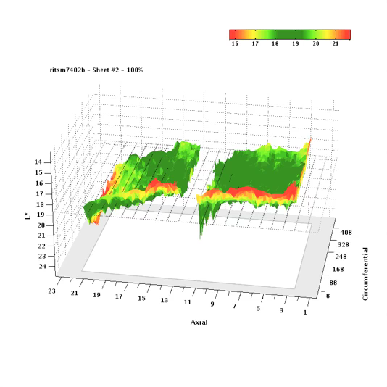
Two Litho Units!

Slide 30
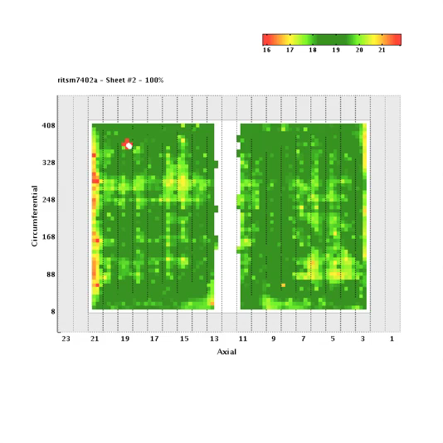
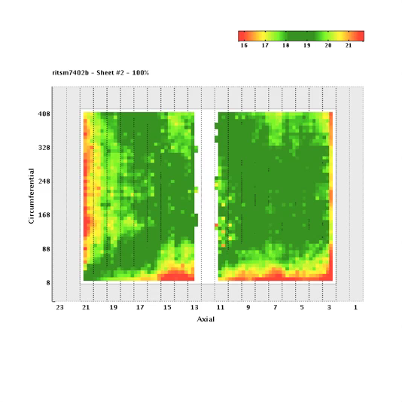
Two Litho Units!

Slide 31
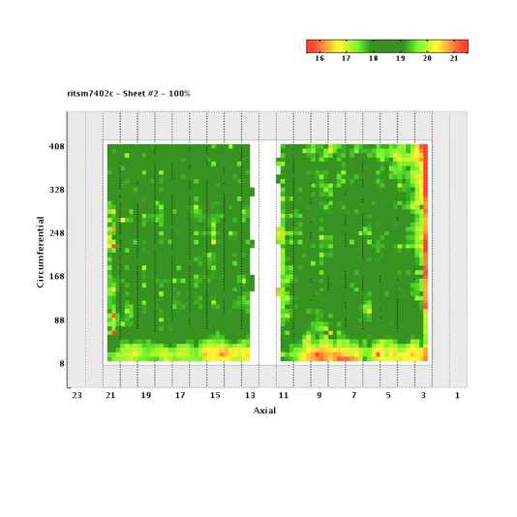
Two Litho Units!

Slide 32
Thank You
Acknowledgements: This work was made possible through the support of several faculty and staff members at the School of Print Media, at Rochester Institute of Technology and the School of Graphic Communications Management, at Ryerson University.

